Slide 1

Neo4j
Jeremy Quinto

Slide 2
Graph Databases
Designed to handle relationships between data without constricting it to a pre-defined model.
Each data point stored is represented as an entity. (Node)
Each entity connects to others who are related to it based on similar features.
Additionally, entities can be tagged with labels for representing different roles in a domain.
This structure allows for data to be managed and handled around a few initial data points, as:
Complex queries can filter out what is visible to the user
The property graph model mapping attributes to constantly evolving data.

Slide 3
Neo4j
Open-source, NoSQL graph database built for production scenario utilization.
Data is stored exactly how it is structured, but schema-optional.
Available to constrict data to a schema, but free to manipulate those values which are not deemed essential.
Uses Cypher, a declarative query language optimized for graphing databases.
Reduces the length of time required to write complex queries.
Analysis on transactioned data and dependencies on millions of data points in real time.

Slide 4
The Goal
Using an example database (either pre-defined or scraped from the web/APIs), explore graph databases using state-of-the-art tools to gain experience in handling large amounts of data in a production-level environment.
Since Neo4j is open-source, optimizations in querying and organizing data were speculated to be possible depending on the structure of the data.
Create documentation on the advances made during this project, and generalize it to other graph databases explored.

Slide 5
The Dataset
Exploring the IMDB (Internet Movie Database) domain as a resource to obtain records to structure a database.
An API is provided by rapidAPI to access particular records of a movie.
IMDB alleviates the need to scrape their web resources for records by providing pre-defined movie datasets in the form of .tsv files for non-commercial purposes.
Different collections are available from their provisioned datasets

Slide 6
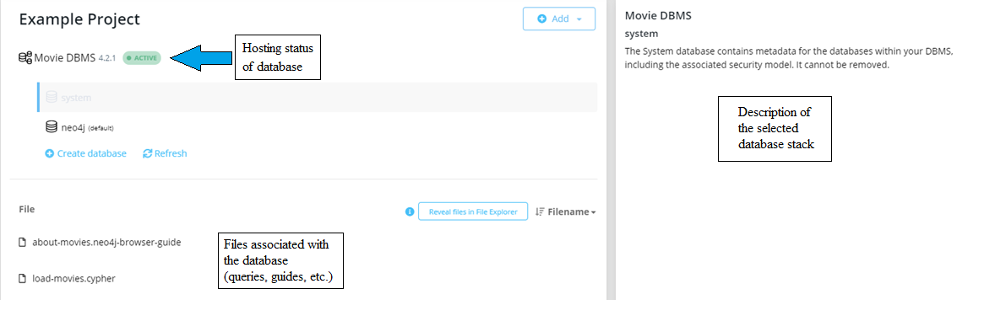
Overview of the Neo4j Interface

Slide 7
Learning Cypher and the Neo4j Browser
Neo4j uses Bolt, a database protocol, to instantiate a browser for communication.
Using this, files associated with a database can be interacted with on a user-level, and applied to the database all in one interactive UI.
When running a query using this browser, multiple formats are provided:
Visual Graph
JSON Structure of the Query (Key:Value pairs)
Table output of the query given
Code output of the query given, includes protocol addresses and payload summary.

Slide 8
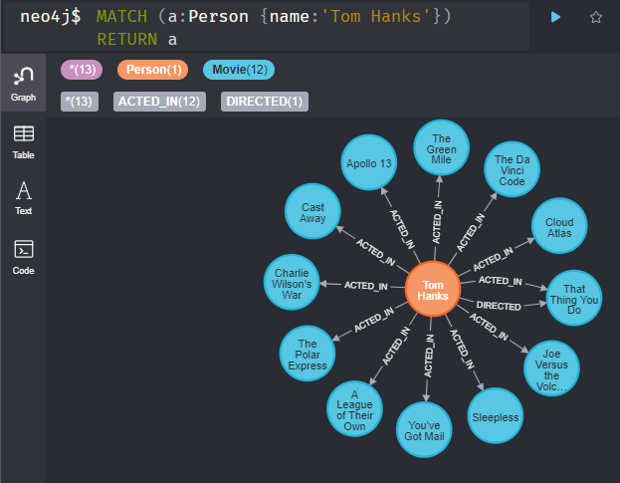
Graph Visualization
Graph Databases are generally expected to have the following characteristics:
Nodes -> Nouns
Relationships -> Verbs
Properties -> Nouns

Slide 9

Cypher Syntax
MATCH searches for graph patterns.
CREATE adds new nodes.
DELETE removes duplicates and relationships of a particular node.
MERGE avoids duplication by combining matching nodes.
Similar to SQL queries, WHERE clauses, and list comprehensions are also possible in using Cypher

Slide 10
The Example Database and IMDB
Neo4j provides an example movie database with a pre-built query in Cypher to generate ~500 different nodes.
The IMDB provided databases utilize .tsv (tab-separated value) files.
These are not inherently supported by Neo4j, though there are external sources that could possibly alleviate this.

Slide 11
Other Graph Databases
At NewSci, we plan to use these types of databases for machine learning purposes as well as visualizations for showing correlations and discrepancies for data accumulated.
New upcoming graph database tools that appear to have potential in relation to ML are:
TigerGraph
Redis
ArangoDB

